Slide 1
Agile Methodology

Slide 2
Agile Methodology

Slide 3
Client and management myths
If you work with a non-Agile aware executive management or client, their expectations will be:
You will accept change continuously
You will suddenly become more productive
You are doing development without any discipline

Slide 4
Why Agile?
Software development is to be adopted for new ways of working and technology changes.
Multi-Platform Delivery
Collaborative development
Cloud Delivery
Intelligent /
Connected Systems
Impacts on Business and Software Development:
Heavy demand for rapid product lifecycles
Increasing interactions with customer
Exploring adjacent or new markets
New skills and competencies needed
Increased security and privacy requirements
Greater need to align with strategic priorities

Slide 5
The Agile manifesto – 2001
We are uncovering better ways of developing software by doing it and helping others do it. Through this work we have come to value:
Individuals and interactions
processes and tools
Working software
comprehensive documentation
Customer collaboration
contract negotiation
Responding to change
following a plan
It means that while there is value in the items on the right, we value the items on the left more.

Slide 6
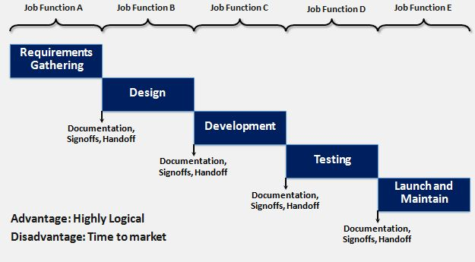
Waterfall model

Slide 7
Empirical processes
The Empirical process is an inspect and adapt process where the product is built incrementally.
Process
Input^{α}
Output^{β}
Inspect and Adapt

Slide 8
Scrum Basics

Slide 9
What is Scrum?
Scrum refers to a holistic or “rugby” approach— where teams go the distance as a unit, passing the ball back and forth—as opposed to the traditional sequential or “relay race” approach for managing new product development.
It is not individual effort but the best coordination of the team that will determine success.

Slide 10
User Stories: Components
1 2 3
A User Story describes functionality that will be useful to a stakeholder of the system.
User Stories consists of three things
A brief description of the story used for planning
Tests that convey and document details
Conversations about the story
4
5
Estimating elements
IBM Customized
Additional Elements
Assumptions

Slide 11
An example of user stories
User Story
Success would be …
Acceptance Test #1
Acceptance Test #2
As a system admin at Wal*Mart, I want to configure WAS so I can manage my applications
Success would be …
WAS is configured
No critical errors occurred in the process
No data was lost

Slide 12
What is an Epic?
As a premium site member, I want to cancel a reservation on the last minute with no cancellation fee so that I am not charged for a travel arrangement I no longer need.
EPIC
As an user, I want to cancel a reservation so that I am not charged for a travel arrangement I no longer need.
User Story
As a premium site member, I want to cancel a reservation on the last minute with no cancellation fee so that I am not charged for a travel arrangement I no longer need.
As a non-premium member, I want to cancel 24 hours in advance so that I am not charged for a travel arrangement I no longer need.
As a site visitor,
I want to receive a confirmation of any cancelled reservation so that I can have proof of cancellations.

Slide 13
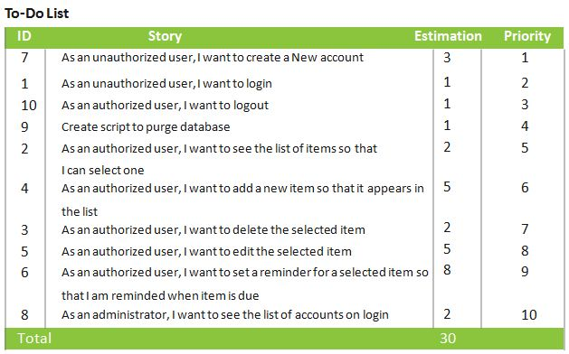
Product Backlog

Slide 14

Case study : Some possible user stories(1 of 6)

Slide 15
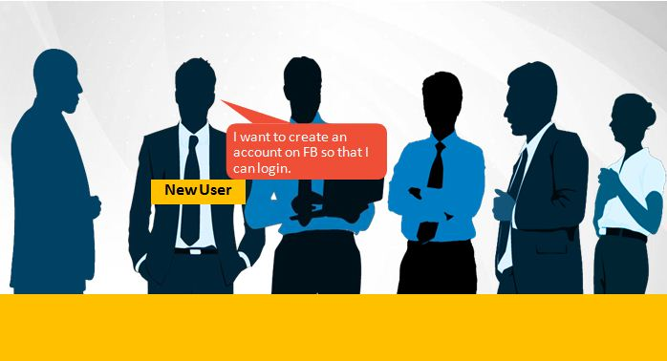
Case study : Some possible user stories(2 of 6)

Slide 16

Case study : Some possible user stories(3 of 6)

Slide 17

Case study : Some possible user stories(4 of 6)

Slide 18

Case study : Some possible user stories(4 of 6)

Slide 19
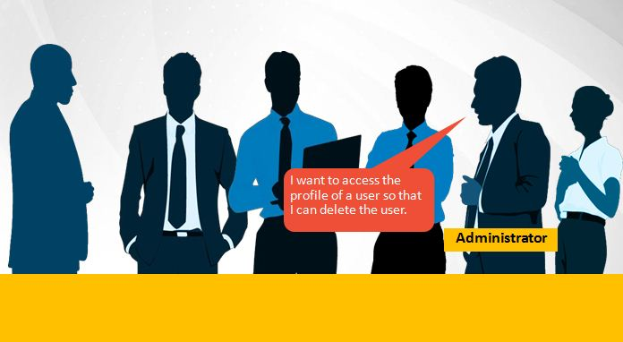
Case study : Some possible user stories(5 of 6)

Slide 20
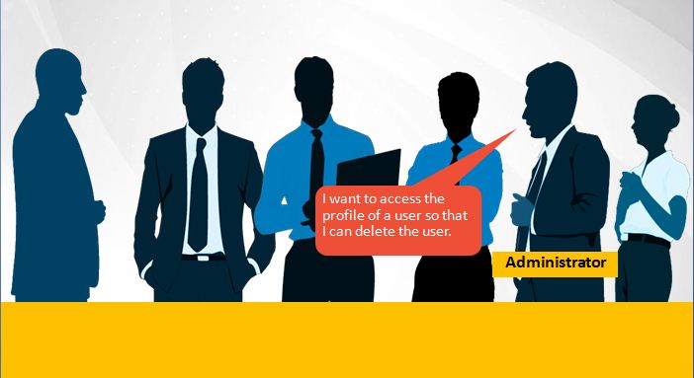
Case study : Some possible user stories(6 of 6)

Slide 21





Scrum roles and responsibilities
Scrum Meeting
Review
Scrum Master
2- WEEK SPRINT
Product Owner
The Team
Commitment
Potentially Shippable product
No Changes (In Duration or Deliverable)
Retrospective

Slide 22
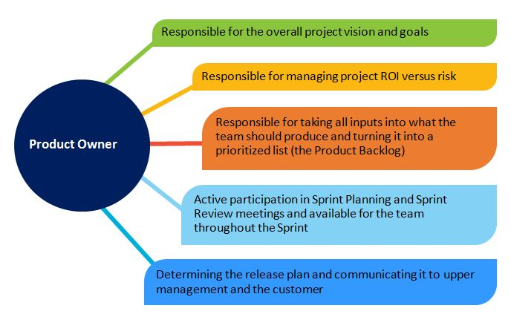
Scrum roles and responsibilities—product owner

Slide 23
Scrum roles and responsibilities—the team
7 people +
or – 2
Can be shared with other teams (but it is better when not)
Can change between Sprints (but better when they don’t)
Can be distributed (but better when collocated)
Cross- functional
Possesses all the skills necessary to produce an increment of potentially shippable product
Team takes on tasks based on skills, not just the official “role”.
Self-managing
Team manages itself to achieve the Sprint commitment.

Slide 24
Scrum Master Roles
Scrum Master
Guides the team’s use of
Scrum
Serves the team
Protects the Team
Guides the team’s use of
Scrum
Teaches Scrum to the team and organization
The Scrum Master takes action to help remove impediments to the team’s effectiveness.
The Scrum Master facilitates the team’s group interactions to help the team achieve its full potential.
The Scrum Master protects the team from anything that threatens its effectiveness, such as outside interference or disruption.
The Scrum Master will need to confront uncomfortable issues, both inside and outside the team.
The Scrum Master ensures that all standard Scrum rules and practices are followed.
The Scrum Master organizes all Scrum- related practices.

Slide 25
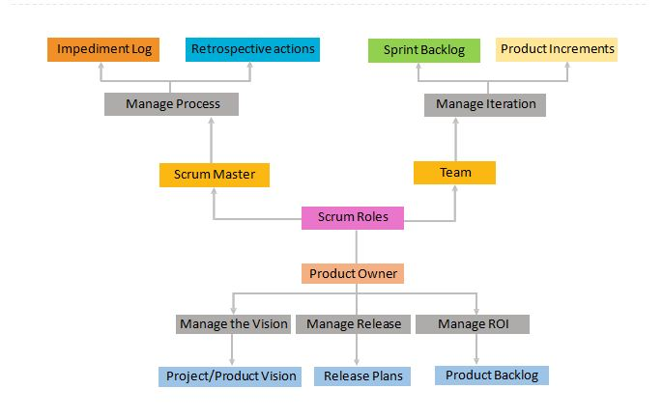
Scrum project roles in a nutshell

Slide 26
Sprint planning
What is on the Product Owner’s “shopping list”?
Team understands details of what Product Owner has prioritized on Product Backlog.
How much “money” do we have in our bank account?
Team decides how much productive time is available during the Sprint.
How many items on the shopping list can we afford to “buy” with that “money”?
Team decides how many Product Backlog items can be committed for completion during the Sprint.

Slide 27
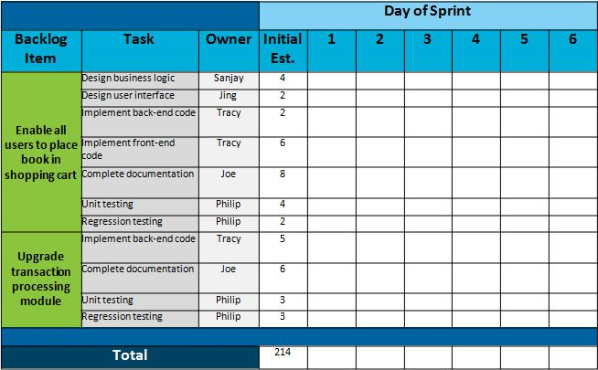
Sprint Backlog

Slide 28
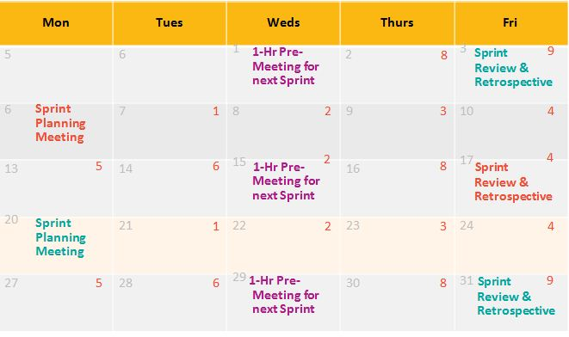
Sprint Cycle: 2 Weeks

Slide 29
Definition of Done
In Scrum, “Done” is defined as “Potentially Shippable”.
RELEASE
RELEASE
RELEASE
RELEASE
RELEASE
RELEASE
S P R I N T
S P R I N T
S P R I N T
S P R I N T
S P R I N T
S P R I N T
RELEASE
S P R I N T
S P R I N T
S P R I N T
S P R I N T
S P R I N T
PRE-RELEASE
S P R I N T

Slide 31
Which one of these life cycle models does Agile follow?
Waterfall Model
Iterative and Incremental Model
V Model

Slide 32
Which of the following prioritized items does the product backlog contain?
Epics
User Stories
Both A & B

Slide 33
Which of the below roles is not defined by Scrum?
Product Owner
Project Manager
Developer / Tester
Scrum Master

Slide 34
Scrum Execution

Slide 35
Daily Scrum Meeting
Every weekday
Whole team attends
Everyone stands
Lasts 15 minutes or less
Product Owner can attend and report
Update of artifacts after standup-Sprint backlog, Task board, and so on

Slide 36
Daily Scrum Meeting (continued)
Every Developer / Tester reports the following three things:
What task was I able to accomplish since yesterday? What task will I try to accomplish for the day?
Any issues blocking my work?
No discussions or conversations until meeting ends

Slide 37
Conduct Daily Scrum Meeting in the following scenario:
There are three developers and two testers working on building a product that will automate the Bank Transactions.
One person is working on Creating new accounts.
Sub-tasks:
Create a Registration/login page.
Add options for User to select Creating new account.
Add all the mandatory / optional fields as text box or combo boxes.
Validate the data entered and the formats and save the data in the database.
Generate the account number and display. One person is working on Creating Fixed Deposit.
Sub-tasks
Provide the user list of FD plans and the rates.
Check if User is already an account holder. If yes, then display a webpage which will get the User account details so that FD account to be linked with S/B account.
One person is working on Generating Reports.
Sub-tasks:

Slide 38
Conduct Daily Scrum Meeting in the following scenario:
Design a screen/page to provide the Report generating options.
Create the tables and views.
Design the report layout for different queries (ex: fetch all the details of Customer XYZ like account summary, FD details, Home loan details and so on.
2 Testers testing first 2 scenarios.

Slide 39
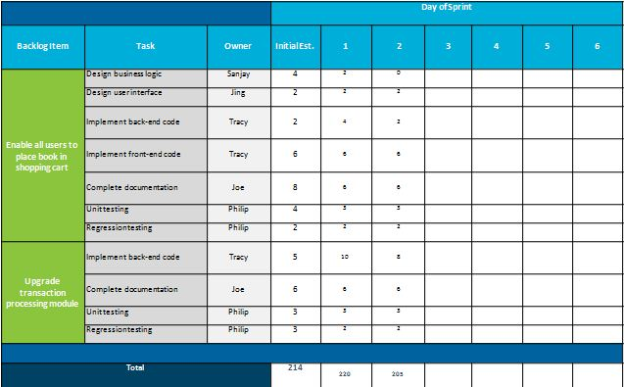
Sprint Backlog Updation

Slide 40
Kanban Task Board (1 of 4)
A Kanban board is a work and workflow visualization tool that enables you to
optimize the flow of your work. Physical Kanban boards, like the one
pictured below, typically use sticky notes on a whiteboard to
communicate status, progress, and issues.
TO DO
IN PROGRESS
DONE

Slide 41
Kanban Task Board (2 of 4)
TO DO
IN PROGRESS
DONE

Slide 42
Kanban Task Board (3 of 4)
TO DO
IN PROGRESS
DONE

Slide 43
Kanban Task Board (4 of 4)
TO DO
IN PROGRESS
DONE

Slide 45
Product Owner has to mandatorily participate in Daily Scrum Meeting.
Yes
No
Not required
Need basis

Slide 46
Sprint backlog is updated by:
Scrum Master
Scrum Team
Scrum Product Owner
Any of the above

Slide 47
Sprint Review and Retrospective

Slide 48
Sprint Review
The purpose of the Sprint Review is:
Demo what the team has built
Generate feedback which the Product Owner can incorporate in the Product Backlog
Attended by Team, Product Owner, ScrumMaster, functional managers, and any other stakeholders
A demo of what’s been built and not a presentation about what’s been built:
No Power Points allowed!
Usually lasts 1-2 hours
Followed by Sprint Retrospective

Slide 49
Sprint Retrospective
What is it?
1-2 hour meeting following each Sprint Demo
Attended by Product Owner, Team, and ScrumMaster
Usually a neutral person will be invited in to facilitate
Presents what is working and what could work better
Why does the Retrospective matter?
Accelerates visibility
Accelerates action to improve

Slide 50
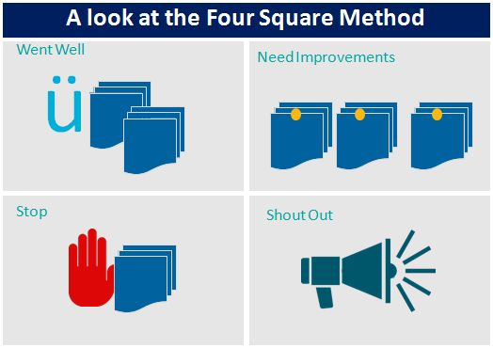
Sprint Retrospective: Four Square Method

Slide 52
Which practice does not fall under technical best practices?
Automated build and Continuous Integration
Automated Regression Testing
Code Review and Rework
None of the above

Slide 53
2. Retrospective meetings help us to:
Identify areas of improvement
Recognize team members
Inspect and Adapt
A & B Only

Slide 54
Agile - Testing

Slide 55
Agile Test Quadrants
Automated
and Manual
Business Facing
Manual
Functional Testing
Examples
Story tests
Prototypes
Simulations
Exploratory Testing
Scenarios
Usability Testing
User Acceptance Testing
Alpha/Beta
Q2 Q3
Critique Product
Performance and load testing
Unit Tests
Component Tests
Security Testing
‘ility’ testing
Q1 Q4
Automated
Tools
Technology Facing

Slide 56
Agile Test Quadrants (continued)
Quadrant 1:
Depicts unit and component tests written by developers
Largely automated and represent a low cost of ensuring that the system works as intended
Quadrant 2:
Depicts user facing story and functional tests
Tests the higher level features of the system and can be both automated and manual
Quadrant 3:
Depicts system-level tests to determine the aggregate behavior of the system meets its usability and functionality requirements
Largely manual since they involve users and testers using the system in actual or simulated
deployment
Quadrant 4:
Ensures the system meets non-functional requirements
Supported by tools such as load, performance, or specialized tools

Slide 57
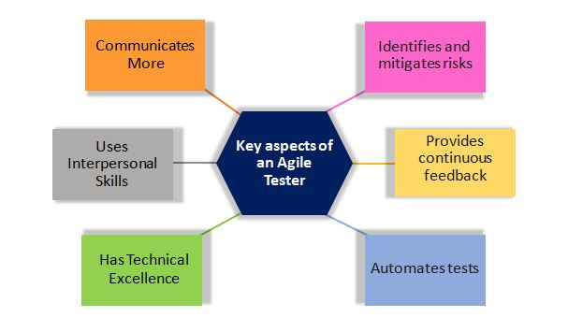
Agile Test Quadrants (continued)
Testers are a seamless part of the team to improve and build quality into the system and work
closely with the product owner. Following are the key aspects of an agile tester.

Slide 58
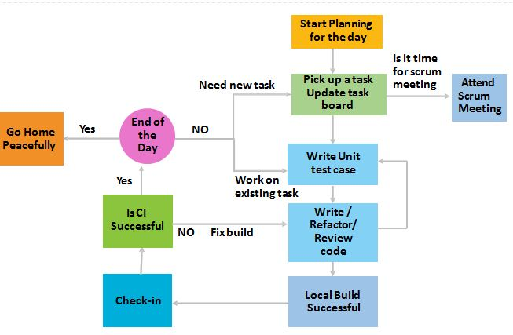
A typical day in the life of a developer

Slide 59
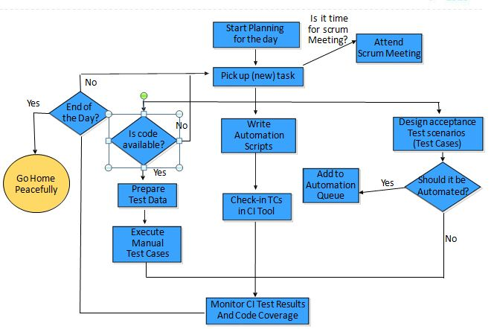
A typical day in the life of a tester

Slide 61
Quadrant 2 in the Agile Test Quadrants depicts
Non-functional tests
User facing story and functional tests
Unit and Component Tests
User facing story and functional tests

